Slide 1
Structured Query Language

Slide 2
Structured Query Language SQL
SQL language

Slide 3
Structured Query Language
SQL language
Data Manipulation Language (DML): subset of SQL allows users to pose queries and do CRUD operations: insert, delete, and modify rows
  SELECT Queries are the main focus of this part
Data Definition Language (DDL): subset of SQL supports the creation, deletion, and modification of definitions for tables and views and Integrity Constraints

Slide 4
Structured Query Language
SQL language
Embedded and Dynamic SQL: embedded SQL features allow SQL code to be called from a host language such as C, Java or Python.
Security: SQL provides mechanisms to control users' access to data objects.
Advanced features: the SQL:1999 standard includes object-oriented features and many others

Slide 5
we will present a number of sample queries using the following table definitions:
  Sailors( sid: integer, sname: string, rating: integer, age: real)
  Boats( bid: integer, bname: string, color: string)
  Reserves (sid: integer, bid: integer, day: date)
the key fields are underlined, and the domain of each field is listed after the field name. Thus, sid is the key for Sailors, bid is the key for Boats, and all three fields together form the key for Reserves

Slide 6
basic form of an SQL query
SELECT [DISTINCT] select-list
FROM from-list
WHERE qualification

Slide 7
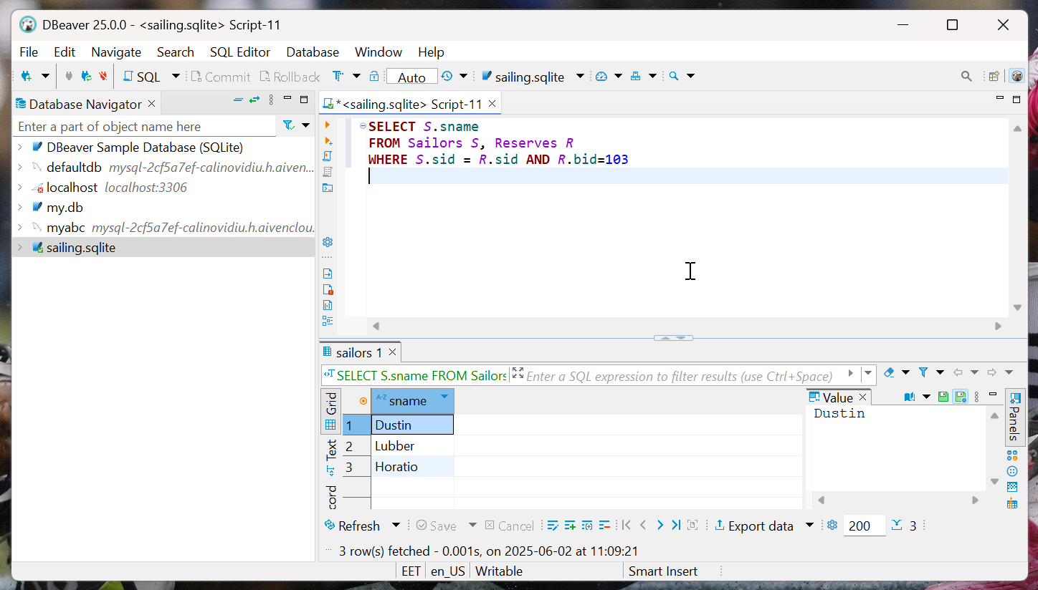

Slide 8
things get complicated …

Slide 9
UNION, INTERSECT, AND EXCEPT
SQL provides three set-manipulation constructs that extend the basic query form presented earlier
since the answer to a query is a multiset of rows, it is natural to consider the use of operations such as union, intersection, and set difference
SQL supports these operations under the names UNION, INTERSECT, and EXCEPT

Slide 11
Nested Queries
query that has another query embedded within it
the embedded query is called a subquery
embedded query can of course be a nested query itself
  deeply nested structures are possible
writing a query, we sometimes need to express a condition that refers to a table that must itself be computed
  query used to compute this subsidiary table is a subquery and appears as part of the main query

Slide 12
subquery typically appears within the WHERE clause of a query
subqueries can sometimes appear in the FROM clause or the HAVING clause

Slide 13
Find the names of sailors who have reserved boat number 103.
SELECT S.sname
FROM Sailors S
WHERE
S.sid IN ( SELECT R.sid
FROM Reserves R
WHERE R.bid = 103 )

Slide 14
the nested subquery computes the (multi)set of sids for sailors who have reserved boat 103 (the set contains 22,31, and 74)
and the top-level query retrieves the names of sailors whose sid is in this set
IN operator allows us to test whether value is in set of elements; SQL query is used to generate the set to be tested

Slide 15
easy to modify this query to find all sailors who have not reserved boat 103 - just replace IN by NOT IN!

Slide 16
Find the names of sailors who have not reserved a red boat.
SELECT S.sname
FROM Sailors S
WHERE S.sid NOT IN ( SELECT R.sid
FROM Reserves R
WHERE R. bid IN (SELECT B.bid
FROM Boats B
WHERE B.color = 'red'))

Slide 17
in the nested queries seen thus far, the inner subquery has been completely independent of the outer query
the inner subquery could depend on the row currently being examined in the outer query (in terms of our conceptual evaluation strategy)

Slide 18
Find the names of sailors who have reserved boat number 103.
SELECT S.sname
FROM Sailors S
WHERE EXISTS ( SELECT *
FROM Reserves R
WHERE R.bid = 103 AND R.sid = S.sid )

Slide 19
Nested corelated queries
the subquery clearly depends on the current row S and must be re-evaluated for each row in Sailors
the occurrence of S in subquery (in the form of literal S.sid) is called a correlation and such queries are called nested corelated queries

Slide 20
EXISTS
the EXISTS operator is another set comparison operator, such as IN
allows to test whether a set is nonempty, implicit comparison with the empty set
thus, for each Sailor row S, we test whether the set of Reserves rows R such that R.bid = 103 AND S.sid = R.sid is nonempty
  if so, sailor S has reserved boat 103, and we retrieve the name

Slide 21
query also illustrates the use of the special symbol * in situations where all we want to do is to check that a qualifying row exists, and do not really want to retrieve any columns from the row.

Slide 22
as a further example, by using NOT EXISTS instead of EXISTS, we can compute the names of sailors who have not reserved boat number 100 or the names of sailors who have not reserved a red boat

Slide 23
SELECT S.sname
FROM Sailors S
WHERE NOT EXISTS ( SELECT *
FROM Reserves R, Boats B
WHERE R.bid = B.bid AND R.sid = S.sid AND b.color = 'red')

Slide 24
op ANY and op ALL
SQL also supports op ANY and op ALL, where op is one of the arithmetic comparison operators {<, <=, =, <>, >=, >}
SOME is also available, but it is just a synonym for ANY

Slide 25
Find sailors whose rating is better than some sailor called Horatio
SELECT S.sid
FROM Sailors S
WHERE S.rating > ANY (
SELECT S2.rating
FROM Sailors S2
WHERE S2.sname = 'Horatio' )

Slide 26
Find sailors whose rating is better than every sailor called Horatio.
SELECT S.sid
FROM Sailors S
WHERE S.rating > ALL (
SELECT S2.rating
FROM Sailors S2
WHERE S2.sname = 'Horatio' )

Slide 27
to understand comparisons involving ANY, it is useful to think of the comparison being carried out repeatedly
in this example, S.rating is successively compared with each rating value that is an answer to the nested query
intuitively, the subquery must return a row that makes the comparison true, in order for S.rating > ANY ... to return true

Slide 28
useful to think of comparison being carried out repeatedly
intuitively, the comparison must be true for every returned row for S.rating> ALL ... to return true

Slide 29
Find the oldest sailors.
SELECT S.sname, S.age
FROM Sailors S
WHERE S.age >= ALL ( SELECT S2.age
FROM Sailors S2 )

Slide 30
Find the oldest sailors in each rating
SELECT S.sname, S.age, S.rating
FROM Sailors S
WHERE S.age >= ALL ( SELECT S2.age
FROM Sailors S2
WHERE S2.rating = S.rating)

Slide 31
Pay attention
I doubt that there is an ALL() operator in SQLite
  however, you can write something that is functionally equivalent using MAX() and MIN()
    More than one way to skin a cat
<= ALL is working
< ALL is not working
pay attention to NULL values

Slide 32
Find the names of sailors who have reserved all boats
SELECT S.sname
FROM Sailors S
WHERE NOT EXISTS (
SELECT B.bid FROM Boats B
EXCEPT
SELECT R. bid FROM Reserves R
WHERE R.sid = S.sid )

Slide 33
Find the names of sailors who have reserved all red boats
SELECT S.sname
FROM Sailors S
WHERE NOT EXISTS (
SELECT B.bid FROM Boats B WHERE B.color = 'red'
EXCEPT
SELECT R.bid FROM Reserves R, Boats B
WHERE R.bid = B.bid AND R.sid = S.sid AND B.color = 'red')

Slide 34
query is correlated - for each sailor S, we check to see that the set of boats reserved by S includes every boat or every red boat

Slide 35
Aggregate Functions
to perform some computation or summarization
powerful class of constructs for computing aggregate values such as MIN and SUM
functions and arithmetic operators have one or two or three or many parameters / operands
aggregate functions and operators have only one single such parameter / operand which happen to be a set of values

Slide 36
Aggregate Functions
Structured Query Language SQL supports five aggregate operations, which can be applied on any column, say A, of a relation:

Slide 37
Aggregate Functions
COUNT ([DISTINCT] A): the number of (unique) values in the A column.
SUM ([DISTINCT] A): the sum of all (unique) values in the A column.
AVG ([DISTINCT] A): the average of all (unique) values in the A column.
MIN (A): the minimum value in column A.
MAX (A): the maximum value in column A.

Slide 38
Find the average age of all sailors
SELECT AVG (S.age)
FROM Sailors S
36.9

Slide 39
Find the average age of all sailors with a rating of 10
SELECT AVG (S.age)
FROM Sailors S
WHERE S.rating = 10
25.5

Slide 40
WHERE clause can be used to restrict the sailors considered in computing the average age
MIN (or MAX) can be used instead of AVG in the above queries to find the age of the youngest (oldest) sailor
however, finding both the name and the age of the oldest sailor is trickier

Slide 41
Find the name and age of the oldest sailor.
SELECT S.sname, MAX (S.age) FROM Sailors S
intent is for this query to return not only the maximum age but also the name of the sailors having that age
query is illegal in SQL
if SELECT clause uses an aggregate operation, then it must use only aggregate operations unless query contains a GROUP BY clause!

Slide 42
must use a nested query to compute the desired answer

Slide 43
Find the name and age of the oldest sailor
SELECT S.sname, S.age
FROM Sailors S
WHERE S.age = (
SELECT MAX (S2.age) FROM Sailors S2 )

Slide 44
used the result of an aggregate operation in the subquery as an argument to a comparison operation
strictly speaking, we are comparing an age value with the result of the subquery, which is a relation (set)
because of the use of the aggregate operation, the subquery is guaranteed to return a single tuple with a single field, and SQL converts such a relation to a field value for the sake of the comparison

Slide 45
Count the number of sailors
SELECT COUNT (*)
FROM Sailors S
10
SELECT COUNT (DISTINCT S.sname)
FROM Sailors S
9

Slide 46
can count number of sailors using COUNT
example illustrates the use of * as an argument to COUNT, which is useful when we want to count all rows
contrast this previously queries, which computes the number of sailors and the number of distinct sailor names
  remember that sname is not a key! and there are two Horatio in the instance

Slide 47
in SQL there are more ways to skin a cat! …
This is not an invitation to cruelty against animals!

Slide 48
Find the names of sailors who are older than the oldest sailor with a rating of 10
SELECT S.sname
FROM Sailors S
WHERE S.age > ALL ( SELECT
S2.age
FROM Sailors S2
WHERE S2.rating = 10 )

Slide 49
Find the names of sailors who are older than the oldest sailor with a rating of 10
SELECT S.sname
FROM Sailors S
WHERE S.age > ( SELECT
MAX ( S2.age)
FROM Sailors S2
WHERE S2.rating = 10 )

Slide 50
thus far, we have applied aggregate operations to all (qualifying) rows in a relation

Slide 51
often, we want to apply aggregate operations to each of several groups of rows in a relation, where the number of groups depends on the relation instance (i.e., is not known in advance)
for example, consider following query: Find the age of the youngest sailor for each rating level
if we know that ratings are integers in range 1 to 10, we could write 10 queries: SELECT MIN (S.age) FROM Sailors S WHERE S.rating = i where i=1...10
writing 10 such queries is tedious and more important; we may not know in advance what rating levels exist.

Slide 52
to write such queries, we need a major extension to basic SQL query form, namely, the GROUP BY clause
extension also includes an optional HAVING clause that can be used to specify qualifications over groups
general form of an SQL query with these extensions is:

Slide 53
general form of SQL query
SELECT [ DISTINCT] select-list
FROM from-list
WHERE qualification
GROUP BY grouping-list
HAVING group-qualification

Slide 54
general form of SQL query.
SELECT [ DISTINCT] select-list
FROM from-list
WHERE qualification
GROUP BY grouping-list
HAVING group-qualification
ORDER BY order-list

Slide 55
Find the age of the youngest sailor for each rating level
SELECT S.rating, MIN (S.age)
FROM Sailors S
GROUP BY S.rating

Slide 56
GROUP BY is partitioning
29 Brutus 1 33.0
85 Art 3 25.5
95 Bob 3 63.5
22 Dustin 7 45.0
64 Horatio 7 35.0
31 Lubber 8 55.5
32 Andy 8 25.5
74 Horatio 9 35.0
58 Rusty 10 35.0
71 Zorba 10 16.0

Slide 57
SELECT * FROM sailors
ORDER BY rating
29 Brutus 1 33.0
85 Art 3 25.5
95 Bob 3 63.5
22 Dustin 7 45.0
64 Horatio 7 35.0
31 Lubber 8 55.5
32 Andy 8 25.5
74 Horatio 9 35.0
58 Rusty 10 35.0
71 Zorba 10 16.0

Slide 58
general form of SQL query
SELECT [ DISTINCT] select-list
FROM from-list
WHERE qualification
GROUP BY grouping-list
HAVING group-qualification

Slide 59
the select-list in the SELECT clause consists of
  (1) a list of column names, expressions with column names
  (2) a list of terms having the form aggregate-operator( column-name) AS newname
columns that are result of aggregate operators do not already have a column name, and therefore giving the column a name with AS is especially useful

Slide 60
every column that appears in (1) must also appear in grouping-list
reason is that each row in result of query corresponds to one group / partition, which is a collection of rows that agree on the values of columns in grouping-list
if a column appears in list (1), but not in grouping-list, there can be multiple rows within a group that have different values in this column, and it is not clear what value should be assigned to this column in answer row

Slide 61
expressions appearing in the group-qualification in the HAVING clause must have a single value per group
HAVING clause determines whether an answer row is to be generated for a given group
if GROUP BY is omitted, entire table is regarded as a single group

Slide 62
Find the age of the youngest sailor who is eligible to vote (at least 18 years old) for each rating level with at least two such sailors
SELECT S.rating, MIN (S.age) AS minage
FROM Sailors S
WHERE S.age >= 18
GROUP BY S.rating
HAVING COUNT (*) >= 2

Slide 63
Extending the conceptual evaluation strategy

Slide 64
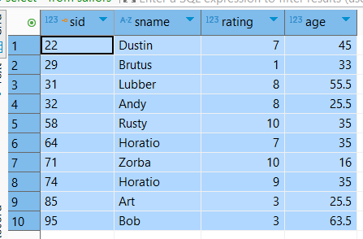
instance of Sailors on which this query is to be evaluated

Slide 65
1st step is to construct the cross product of tables in the from-list

Slide 66
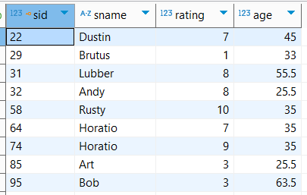
2nd step is to apply the qualification in the WHERE clause, S. age >= 18

Slide 67
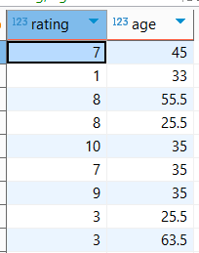
3rd step is to eliminate unwanted columns

Slide 68
only columns mentioned in SELECT clause, GROUP BY clause, or HAVING clause are necessary

Slide 69
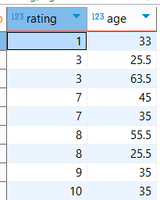
4th step is to sort table according to GROUP BY clause to identify the groups

Slide 70
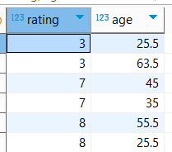
5th step ,is to apply group-qualification in HAVING clause, that is, the condition COUNT (*) >= 2

Slide 71
order in which the WHERE and GROUP BY clauses are considered is significant
if the WHERE clause were not considered before, the group with rating = 10 would have met the group-qualification in the HAVING clause

Slide 72
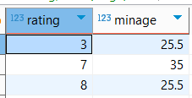
6th step is to generate one answer row for each remaining group

Slide 73
generate one answer row for each remaining group and each answer row has a rating column and a minage column, which is computed by applying MIN to the values in the age column of the corresponding group

Slide 74
For each red boat, find the number of reservations for this boat
SELECT B.bid, COUNT (*) AS reservationcount
FROM Boats B, Reserves R
WHERE R.bid = B.bid AND B.color = 'red'
GROUP BY B.bid

Slide 75
Find the age of the youngest sailor who is eligible to vote (at least 18 years old) for each rating level with at least two such sailors
SELECT S.rating, MIN (S.age) AS minage
FROM Sailors S
WHERE S.age >= 18
GROUP BY S.rating
HAVING COUNT (*) >= 2

Slide 76
Find the average age of sailors for each rating level that has at least two sailors
SELECT S.rating, AVG (S.age) AS avgage
FROM Sailors S
GROUP BY S.rating
HAVING COUNT (*) >= 2

Slide 77
Find the average age of sailors who are of voting age (i.e. at least 18 year8 old) for each rating level that has at least two sailors
SELECT S.rating, AVG ( S.age ) AS avgage
FROM Sailors S
WHERE S. age >= 18
GROUP BY S.rating
HAVING 2 <= ( SELECT COUNT (*)
FROM Sailors S2
WHERE S.rating = S2.rating )

Slide 78
Find the average age of sailors who are of voting age (i.e., at least 18 years old) for each rating level that has at least two such sailors
SELECT S.rating, AVG ( S.age ) AS avgage
FROM Sailors S
WHERE S. age> 18
GROUP BY S.rating
HAVING 2 < ( SELECT COUNT (*)
FROM Sailors S2

Slide 79
NULL Values
column values can be unknown …

Slide 80
NULL Values
for example, when a new sailor joins a club, she/he may not yet have a rating assigned; since the definition for Sailors table has a rating column, what value should be inserted in the row
needed here is a special value that denotes unknown
if the Sailor table definition modified to include a maiden-name column, only married women who take their husband's last name have a maiden name
for women who do not take their husband's name and for men, maiden-name column is inapplicable

Slide 81
NULL Values
SQL provides a special column value called null to use in such situations
use null when column value is either unknown or inapplicable
might enter in Sailor table the row (98, Calin, null, 55) to represent a new sailor

Slide 82
null is null
number, character strings, calendar date and time could be null
presence of null values complicates many issues

Slide 83
reasonable to say that comparison between values and null should be evaluated to value unknown, null
SQL provides a special comparison operator IS NULL to test whether a column value is null;
must define the logical operators AND, OR, and NOT using a three-valued logic in which expressions evaluate to true, false, or unknown null

Slide 84
eliminating rows that evaluate to unknown null have a subtle but significant impact on queries, especially nested queries involving EXISTS
definition of when two rows in a relation instance are regarded as duplicates: two rows are duplicates if corresponding columns are either equal, or both contain null
  contradicting definition with the fact that if we compare two null values using =, the result is unknown

Slide 85
arithmetic operations +, -, *, and / all return null if one of their arguments is null
nulls can cause some unexpected behavior with aggregate operations
  COUNT(*) handles null values just like other values; that is, they get counted
  all the other aggregate operations (COUNT, SUM, AVG, MIN, MAX, and variations using DISTINCT) simply discard null values

Slide 86
JOIN following queries return the same data
Find the names of sailors and the boats reserved
Find the names of sailors and the boats reserved
SELECT S.sid, S.sname, B.bid, B.bname, B.color, R.day
FROM Sailors S, Reserves R, Boats B
WHERE S.sid = R.sid AND R.bid = B.bid
SELECT S.sid, S.sname, B.bid, B.bname, B.color, R.day
FROM Sailors S
JOIN Reserves R ON S.sid = R.sid
JOIN Boats B ON R.bid = B.bid

Slide 87
JOIN
join operation allow programmers to write some queries in a more natural way
NATURAL JOIN, NATURAL keyword specifies that the join condition is equality on all common attributes (in this example, sid and bid), and the WHERE clause is not required (unless we want to specify additional, non-join conditions)

Slide 88
JOIN following queries return the same data
Find the names of sailors and the boats reserved
Find the names of sailors and the boats reserved
SELECT S.sid, S.sname, B.bid, B.bname, B.color, R.day
FROM Sailors S, Reserves R, Boats B
WHERE S.sid = R.sid AND R.bid = B.bid
SELECT S.sid, S.sname, B.bid, B.bname, B.color, R.day
FROM Sailors S
JOIN Reserves R ON S.sid = R.sid
JOIN Boats B ON R.bid = B.bid

Slide 89
first query can be written more concisely using the join operation in SQL and both above queries will generate the same result data set
result of natural join operation is relation (also the Cartesian product of relation it is a relation)
conceptually, expression “Sailors natural join Reserves” in the from clause is replaced by relation obtained by evaluating natural join
where and select clauses are evaluated on this resulted new relation

Slide 90
from clause in an SQL query can have multiple relations combined using natural join or join

Slide 91
JOIN
Equi Join non Equi Join and Non-Equi Join in SQL
Equi Join is any JOIN operation that uses only and only the equals sign
Non-Equi Join joins table on the basis of conditions other than the equality conditions, such as !=, >, <, BETWEEN, etc.
Natural Join specifies that the join condition is equality on all common attributes, attributes with same name

Slide 92
to provide benefit of natural join while avoiding danger of equating attributes erroneously, SQL provides form of natural join construct that allows you to specify exactly which columns should be equated
SELECT S.sid, S.sname, B.bid, B.bname, B.color, R.day
FROM Sailors S
JOIN Reserves R ON S.sid = R.sid
JOIN Boats B ON R.bid = B.bid

Slide 93
SQL supports join, in which arbitrary join condition can be specified
the on condition allows general predicate over relations being joined; predicate written like a where clause predicate except for the use of keyword on rather than where
on condition specifies that a tuple from Sailors matches a tuple from Reserves if their sid values are equal

Slide 94
difference between on and natural is that the result has the sid attribute listed twice, in join result, once for sailor and once for reserve, even though their sid values must be the same in natural join
the relation’s name is used to disambiguate the attribute name sid, and thus the two occurrences can be referred to as sailors.sid and reserves.sid, respectively
result of this query is the same as the result of the natural join

Slide 95
JOIN following queries return the same data
Find the names of sailors and the boats reserved
better …
SELECT S.sid, S.sname, B.bid, B.bname, B.color, R.day
FROM Sailors S, Reserves R, Boats B
WHERE S.sid = R.sid AND R.bid = B.bid
SELECT S.sid, S.sname, B.bid, B.bname, B.color, R.day
FROM Sailors S
JOIN Reserves R ON S.sid = R.sid
JOIN Boats B ON R.bid = B.bid

Slide 96
the on condition can express any SQL predicate and thus join expressions using on condition can express a richer class of join conditions than natural join

Slide 97
two very good reasons for introducing on condition
  we shall see shortly that for a kind of join called an outer join, on conditions do behave in a manner different from where conditions
  an SQL query is often more readable by humans if the join condition is specified in the on clause and the rest of the conditions appear in the where clause
  execution could be optimized …

Slide 98
JOIN following queries return the same data
Find the names of sailors and the red boats reserved
Find the names of sailors and the red boats reserved
SELECT S.sid, S.sname, B.bid, B.bname, B.color, R.day
FROM Sailors S, Reserves R, Boats B
WHERE S.sid = R.sid AND R.bid = B.bid AND B.color – 'red'
SELECT S.sid, S.sname, B.bid, B.bname, B.color, R.day
FROM Sailors S
JOIN Reserves R ON S.sid = R.sid
JOIN Boats B ON R.bid = B.bid
WHERE B.color = 'red'

Slide 99
JOIN default is Inner Join
Find the names of sailors and the red boats reserved
Find the names of sailors and the red boats reserved
SELECT S.sid, S.sname, B.bid, B.bname, B.color, R.day
FROM Sailors S
JOIN Reserves R ON S.sid = R.sid
JOIN Boats B ON R.bid = B.bid
WHERE B.color = 'red'
SELECT S.sid, S.sname, B.bid, B.bname, B.color, R.day
FROM Sailors S
INNER JOIN Reserves R
  ON S.sid = R.sid
INNER JOIN Boats B
  ON R.bid = B.bid
WHERE B.color = 'red'

Slide 100
Outer JOIN
to display a list of all sailors, displaying their name, along with the boats that they have taken, displaying their boat name and color together with the day of the reservation
query does not work quite as intended if there are some sailors who reserves no boat
tuple in Sailors relation for that particular sailor would not satisfy the condition of a natural join with any tuple in the Reserves relation, and that sailor’s data would not appear in the result

Slide 101
thus, not see any information about sailors who have not reserved any boats
for example, Andy (together with Rusty, Brutus, Art, Bob and Zorba) has made no reserve on boats; appears in Sailor, but Andy’s sid number does not appear in the sid column of Reserves
thus, Andy does not appear in result of natural join

Slide 102
Find the names of sailors and the boats reserved
Find the names of all sailors and the boats reserved
SELECT S.sid, S.sname, B.bid, B.bname, B.color, R.day
FROM Sailors S
JOIN Reserves R ON S.sid = R.sid
JOIN Boats B ON R.bid = B.bid
SELECT S.sid, S.sname, B.bid, B.bname, B.color, R.day
FROM Sailors S
LEFT OUTER JOIN Reserves R ON S.sid = R.sid
LEFT OUTER JOIN Boats B ON R.bid = B.bid

Slide 103
22 Dustin 101 Interlake blue 1
22 Dustin 102 Interlake red 1
22 Dustin 103 Clipper green 2
22 Dustin 104 Marine red 3
31 Lubber 102 Interlake red 4
31 Lubber 103 Clipper green 5
31 Lubber 104 Marine red 6
64 Horatio 101 Interlake blue 7
64 Horatio 102 Interlake red 8
74 Horatio 103 Clipper green 8
22 Dustin 101 Interlake blue 1
22 Dustin 102 Interlake red 1
22 Dustin 103 Clipper green 2
22 Dustin 104 Marine red 3
29 Brutus
31 Lubber 102 Interlake red 4
31 Lubber 103 Clipper green 5
31 Lubber 104 Marine red 6
32 Andy
58 Rusty
64 Horatio 101 Interlake blue 7
64 Horatio 102 Interlake red 8
71 Zorba
74 Horatio 103 Clipper green 8
85 Art
95 Bob

Slide 104
22 Dustin 101 Interlake blue 1
22 Dustin 102 Interlake red 1
22 Dustin 103 Clipper green 2
22 Dustin 104 Marine red 3
29 Brutus
31 Lubber 102 Interlake red 4
31 Lubber 103 Clipper green 5
31 Lubber 104 Marine red 6
32 Andy
58 Rusty
64 Horatio 101 Interlake blue 7
64 Horatio 102 Interlake red 8
71 Zorba
74 Horatio 103 Clipper green 8
85 Art
95 Bob

Slide 105
generally, some tuples in either or both of the relations being joined may be “lost” in this inner way
outer-join operation works in a manner similar to the default inner join operations, but it preserves those tuples that would be lost in a join by creating tuples in the result containing null values

Slide 106
for example, to ensure that sailor named Andy from our earlier example appears in the result, a tuple could be added to the join result with all attributes from the Sailors relation set to the corresponding values for Andy and all the remaining attributes which come from the Reserves and Boats relation set to null
thus, the tuple for the sailor Andy is preserved in the result of the outer join

Slide 107
Forms of outer join
left outer join preserves tuples only in the relation named before (to the left of) the left outer join operation
right outer join preserves tuples only in the relation named after (to the right of) the right outer join operation
full outer join preserves tuples in both relations
right outer join is symmetrical to left outer join
full outer join is a combination of left and right outer join types

Slide 108
in contrast, the join operations we presented earlier that do not preserve nonmatched tuples are called inner join operations, to distinguish them from outer join operations
keyword inner is optional; default join type, when the join clause is used without outer prefix, is the inner join

Slide 109
compute the left outer-join operation as follows:
compute result of inner join
for every tuple t in left-hand-side relation that does not match any tuple in right-hand-side relation in inner join, add a tuple r to result of the join constructed as follows:
  attributes of tuple r that are derived from left-hand-side relation are filled in with the values from tuple t
  remaining attributes of r are filled with null values

